Slide 1
Client Side Scripting
CSS Revision

Slide 2
CSS Introduction
Cascading Style Sheets (CSS) provide the presentation to your HTML document.
CSS defines how to display HTML elements:
HTML defines the content
CSS defines the format
It is ideal separate concerns to make things more maintainable
CSS information is stored in an External Style Sheet (.css files)
Using CSS, you can control the color of the text, the style of fonts, the spacing between paragraphs, how columns are sized and laid out, what background images or colors are used, as well as a variety of other effects.

Slide 3
CSS Benefits
CSS saves time - You can write CSS once and then reuse the same sheet in multiple HTML pages.
Due to this, it also simplifies site updates since you can modify the styles to change the look completely of all HTML documents.
Pages load faster – When using CSS, the LOC (Lines of Code) will be less, and less means faster download times
Superior styles to HTML - CSS has a much wider array of attributes than HTML, so you can give a far better look to your HTML page in comparison to HTML
Multiple Device Compatibility

Slide 4
Defining and applying a Style
A style rule is composed of two parts:
The selector
Locates the elements in the HTML document that will be styled
The declaration block
Contains the formatting instructions (declarations)
Multiple declarations are always separated with a semicolon
A declaration comprises a CSS property, followed by a colon, followed by a value

Slide 5
Defining and applying a Style
The following is an example of a style rule that locates the element and sets the background color to white and the font color to gray.
body {
background-color: white;
color: gray;
}

Slide 6
CSS Comments
You can add comments within a style sheet by using the /* characters to start the comment and the */ characters to end the comment.
Comments may also span multiple lines, as shown in the following example.
/* This is the style
for the body element */
body {
background-color: white; /* The rgb value is #ffffff */
color: gray; /* This is the font color */
}

Slide 7
Selectors
Type Selector: This allows you to select all tags to which the CSS file is attached by specifying the tag itself e.g:
h1 { color: #36CFFF; }
Descendent Selector: This allows you to select nested items e.g:
ul li{ color: #000000; }
This would effectively change the colour of the li within all unordered lists. Descendent selectors separate between parent child by means of a space.
Child Selector: This allows you to select items which are DIRECT CHILDREN of a parent element e.g:
h1>h2{ color: #000000; }
This would change the colour of the h2 tags that are direct children of h1. To make things clearer:
<h1> <p> <h2> Hello </h2> </p> </h1>
<h1> <h2> Hello </h2> </h1>
Not affected by rule
Affected by rule

Slide 8
Selectors
Class Selector: applies style to an element with a particular class and is denoted by a . preceding the selector name e.g
.theLabel {color: #000000; }
would apply style to any element on the page with a class=“theLabel” attribute.
ID Selector: applies style to an element with a particular id and is denoted by a # preceding the selector name e.g
#theLabel {color: #000000; }
would apply style to that element having an id=“theLabel” attribute.
Id’s should be unique.

Slide 9
Selectors
Compound Selector: combines more than one selector e.g
h1.black { color: #000000; }
This is a Type Selector combined with a Class Selector.
This would read “apply style to all those h1 tags having class=“black”
Attribute selector: You can select elements depending on the attributes that they have e.g
table[border]
Selects all tables having a border attribute
Grouping selectors: possible by means of a comma so a rule with h1, h2 , h3 { } as selectors would equally format all h1 elements h2 elements and h3 elements with the same rule.

Slide 10
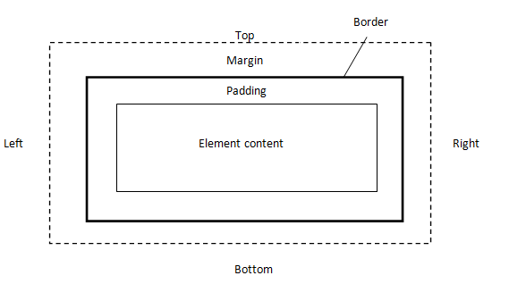
Block-level element
Padding, the area separating the content from the border.
Border, the normally visible line or decoration that surrounds the padding.
Margin, the area separating the border from it’s containing block, such as the page or parent block.

Slide 11

CSS & HTML Practice
Access Moodle and continue the rest of the questions of Worksheet 1

Slide 12
References
Johnson, G. (2013). Programming in HTML5 with Javascript and CSS3. United States of America: Microsoft Press.

